Slide 1
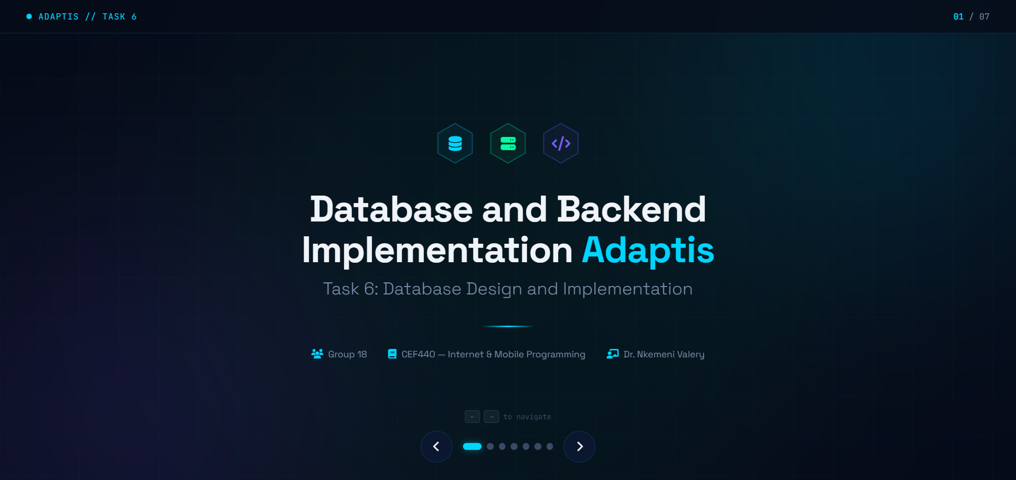

Slide 2


Slide 3


Slide 4
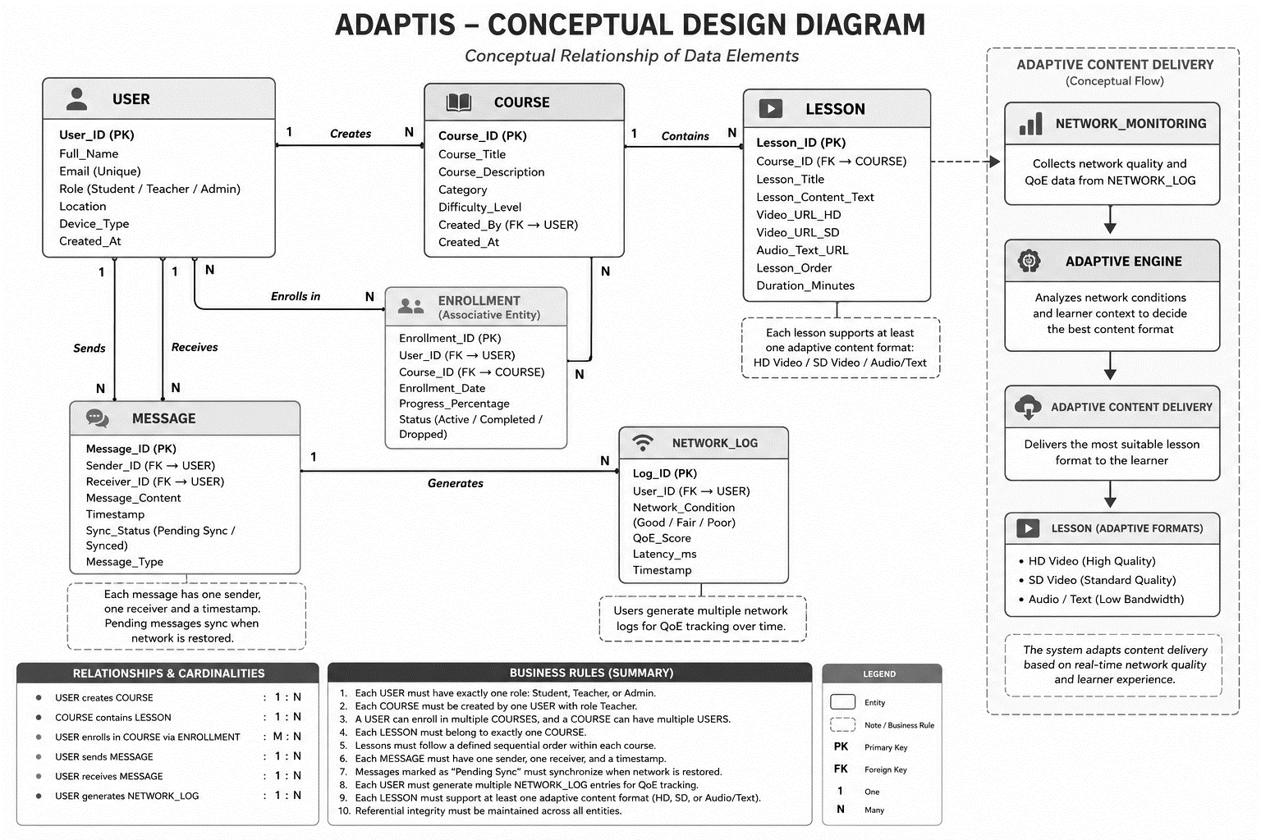
Conceptual design diagram

Slide 5
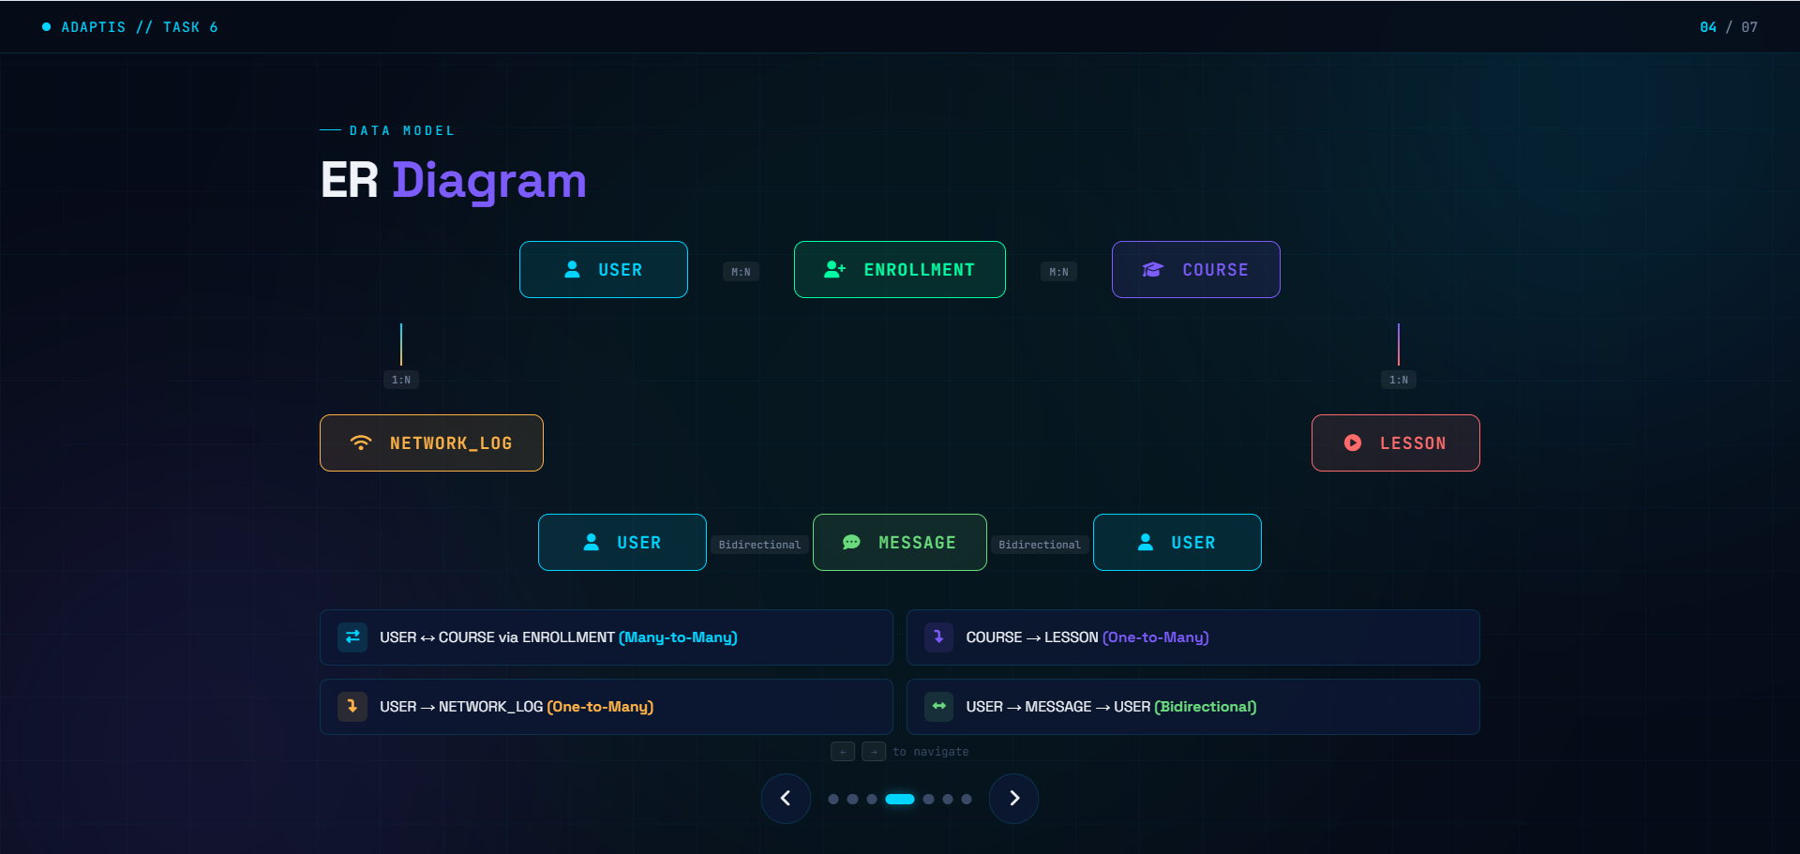

Slide 6
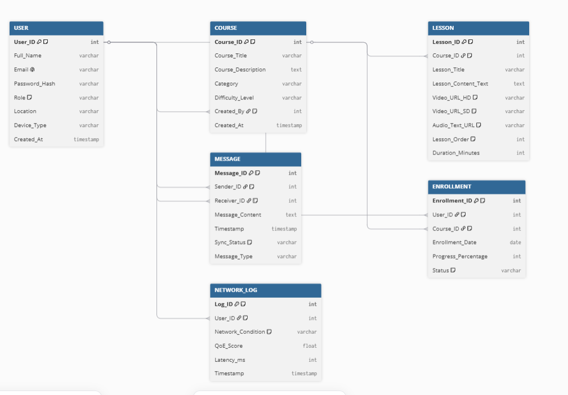
ER - Diagram

Slide 7


Slide 8


Slide 9
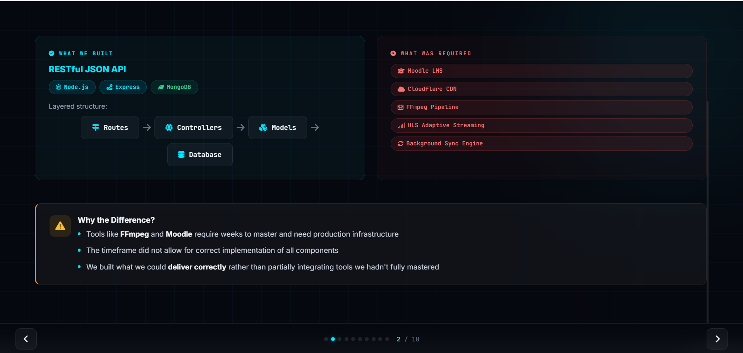

Slide 10
